Slide 1
Documentum Objects and Types
Notes:
Place the audio notes for this slide here

Slide 2

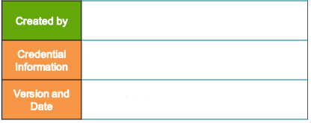
Kishore Manne
Documentum Objects and Types.
V 0.2, 5th April 2018.

Slide 3
Agenda
This training provides information on :
Documentum Objects.
Describe Documentum Objects.
Understand Object-Relational Model.
Understand Object Properties.
Understand Methods.
Hands-on exercise for objects creation.
Documentum Object Types.
Describe Documentum Object Types.
Understand Object Type Names..
Understand Object Type Hierarchy.
Understand Object ID.
Hands-on exercise for Object Type creation.

Slide 4
Documentum Objects

Slide 5
Documentum Objects Overview
This chapter provides information on :
Describe a Documentum Object.
Understanding the object-relational model.
What are properties?
What are methods?
Working with Objects.
Viewing and Editing Object properties.

Slide 6
What is a Documentum Object ?
Documents, cabinets, folders, users and everything in the Documentum repository are objects
An Object stores its state in fields (variables in some programming languages) and exposes its behavior through methods (functions in some programming languages).
A Documentum object stores data in its properties (also known as attributes) and has methods that can be used to interact with the object.
An object is defined by its properties and methods
- Properties describe an object
- Methods describe actions that can be performed on an object

Slide 7
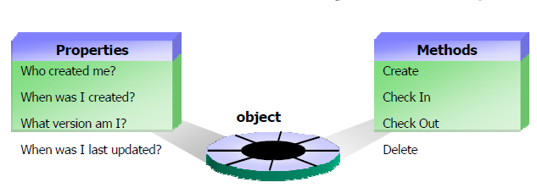
What is a Documentum Object ?
Object definition graphically :
Documentum uses an object-oriented model to store information within the repository.

Slide 8
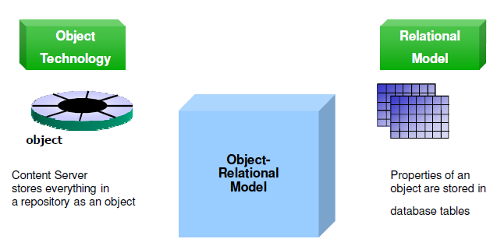
Understanding Object-relational model.
The Content Server manages content using object-relational technology.

Slide 9
Understanding Object-relational model.
Content Server stores everything in a repository as an object.
Objects has properties and they are stored in the database tables.
There are two types of tables in Documentum namely Single Valued tables and Repeating tables. (You will learn in more detail in coming slides) .
Single valued tables stores single valued properties of objects.
Single valued tables has an “_s” suffixed in their names.
Ex: type_name_s
Repeating tables stores repeating properties of an object.
Single valued tables has an “_r” suffixed in their names.
Ex: type_name_r
Both single and repeating tables have r_object_id column which is used to join the single-valued and repeating properties.

Slide 10

Object Properties
All properties can be referred to by their internal name or their label.
The internal name is the name of the property as it is represented in the database.
The internal name is used in DQL queries.
The internal name used by programs and applications.
The label is used for display purposes only and appears in a client user interface

Slide 11
Object Properties
A content item stored in the repository has an associated object to store its metadata.
Metadata is stored in object properties.
The term metadata and properties are used interchangeably.
- For example, a document stored in the repository may have its title, subject, and keywords stored in the associated object.
However, note that objects can exist in the repository without an associated content item.
Such objects are sometimes referred to as contentless objects.
- For example, user objects and permission set objects do not have any associated content.
Each object property has a data type, which can be one of boolean, integer, string, double, time, or ID.

Slide 12
Object property data types
Each object property has a data type, which can be one of Boolean, integer, string, double, time, or ID.
A Boolean value is true or false.
A string value consists of text.
A double value is a floating point number.
A time value represents a timestamp, including dates.
An ID value represents an object ID that uniquely identifies an object in the repository.
Object IDs are discussed in detail later in coming slides.
A property can be single-valued or repeating.

Slide 13
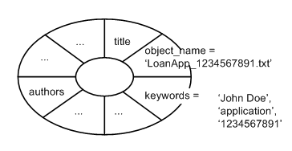
Property categories.
The properties can be categorized into single-valued or repeating.
Each single-valued property holds one value.
- For example, the property, object_name property of a document contains one value and it is of type string.
- This means that the document can only have one name.
On the other hand, keywords is a repeating property and can have multiple string values.
-For example, a document may have object_name = ‘LoanApp_1234567891’ and keywords='John Doe','application','1234567891'.
The following figure shows a visual representation of this object.

Slide 14
Property Name Prefixes
Some property names contain a Documentum prefix.
Below is the table explaining the prefixes
Properties with prefix ‘r_’ :
- Read only to user and applications.
- They are set by Content Server.
Example: r_object_id,r_creation_date.
Properties with prefix ‘i_’ :
- They are internal to Documentum.
- Read only to user and applications.
- They are set and maintained by Content server.
- They are not seen by user and applications.
Example: i_folder_id,i_chronicle_id.
Properties with prefix ‘a_’ :
- They are primarily intended for application usage.
- They are Read and Write for users and application.
Example: a_content_type,a_full_text.

Slide 15
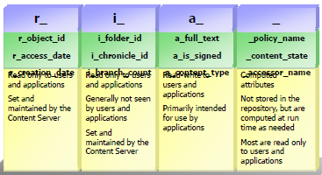
Property Name Prefixes
Properties with prefix ‘_’ :
- They are primarily Computed attributes.
- They are not stored in repository and are computed at runtime.
- They are read-only to users and applications.
Example: _policy_name,_content_state.

Slide 16
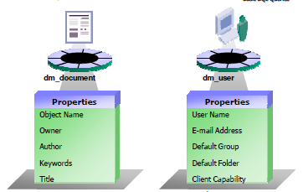
Difference between objects
Not all the objects have same properties.
In the above illustration, object dm_document has different properties than the dm_user.

Slide 17
Methods
Methods are operations that can be performed on an object.
An operation often alters some properties of the object.
- For example, the checkout method can be used to check out an object.
- Checking out an object sets the r_lock_owner property with the name of the user performing the checkout.
Methods are usually invoked using Documentum Foundation Classes (DFCs) programmatically, though they can be indirectly invoked using API.
In general, Documentum Query Language (DQL) cannot be used to invoke arbitrary methods on objects.
DQL is discussed later in this Training.

Slide 18
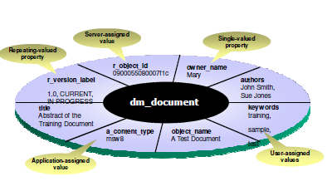
Object Example

Slide 19
Working with objects
We use Documentum UI (DA or Webtop or custom app) for performing various operations on documents, where the term document referred to an object with content.
Some of these operations are not specific to content and apply to objects in general.
- For example, checkout and checkin can be performed on contentless objects as well.
On the other hand, import, export, and renditions deal specifically with content.
Talking specifically about operations on metadata, we can view, modify, and export object properties using Documentum UI .

Slide 20
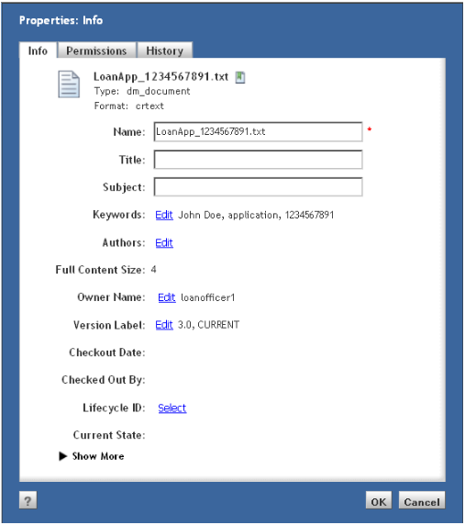
Viewing and Editing properties
Using Webtop/DA, object properties can be viewed using the View | Properties menu item, shortcut P, or the right-click context menu.
The following screenshot shows the properties of the example object discussed earlier.
Note that the same screen can be used to modify and save the properties as well.

Slide 21
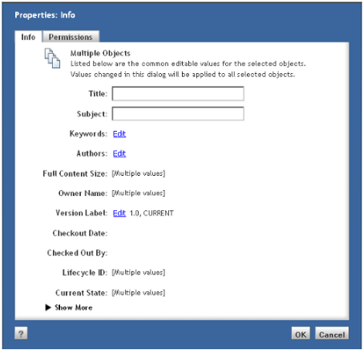
Viewing and Editing properties
Multiple objects can be selected before viewing properties.
In this case, a special dialog shows the common properties for the selected objects, as shown in the following figure.
Any changes made on this dialog are applied to all the selected objects.

Slide 22
Viewing and Editing properties
On the properties screen, single-valued properties can be edited directly while repeating properties provide a separate screen for editing through Edit links.
Some properties cannot be modified by users at any time which are prefixed by ‘r_’ ,’i_’ and ’_’.
Other properties may not be editable because object security prevents it or if the object is immutable.
Certain operations on an object mark it as immutable, which means that object properties cannot be changed.
An object is marked immutable by setting r_immutable_flag to true.
Content Server prevents changes to the content and metadata of an immutable object with the exception of a few special attributes that relate to the operations that are still allowed on immutable objects.
For example, users can set a version label on the object, link the object to a folder, unlink it from a folder, delete it, change its lifecycle, and perform one of the lifecycle operations such as promote/demote/suspend/resume.
The attributes affected by the allowed operations are allowed to be updated.

Slide 23
Viewing and Editing properties
An object is marked immutable in the following situations:
- When an object is versioned or branched, it becomes an old version and is marked immutable.
- An object can be frozen which makes it immutable and imposes some other restrictions. Some virtual document operations can freeze the involved objects.
- A retention policy can make the documents under its control immutable. - Certain operations such as unfreezing a document can reset the immutability flag making the object changeable again.

Slide 24
Exporting properties
Metadata can be exported from repository lists, such as folder contents and search results.
Property values of the objects are exported and saved as a .csv (comma-separated values) file, which can be opened in Microsoft Excel or in a text editor.
Metadata export can be performed using Tools | Export to CSV menu item or the right-click context menu.
Before exporting the properties, the user is able to choose the properties to export from the available ones.

Slide 25
Summary :
An Object stores its state in fields (variables in some programming languages) and exposes its behavior through methods (functions in some programming languages).
Content Server stores everything in a repository as an object.
An object is defined by its properties and methods
Documentum uses an object-oriented model to store information within the repository.
Not all the objects have same properties.
We use Documentum UI (DA or Webtop or custom app) for performing various operations on objects.

Slide 26
Test Your Knowledge
The RDBMS table dm_sysobject_s contains the ______ -valued properties of the dm_document type.
Documentum uses an _____________ model to store information within the repository.
A Documentum object stores data in its ______________
Folders
Cabinets
Properties
Methods
4. _________describe actions that can be performed on an object
Cabinets
Properties
Methods
Documents
(Check Notes for Answers )
Notes:
Answers:
Single
object-oriented
C
C

Slide 27
Test Your Knowledge
5. True/False An ID value represents an object ID that uniquely identifies an object in the repository.
6. Properties that are read and write to users and applications :
Properties with prefix ‘a_’ :
Properties with prefix ‘i_’ :
Properties with prefix ‘r_’ :
Properties with prefix ‘_’ :
7. Operations like checkout and checkin can be performed on objects with contents. True/False
8. Methods are usually invoked using __________________ programmatically,
(Check Notes for Answers )
Notes:
Answers:
5. True
6. A
7. False
8. Documentum Foundation Classes (DFCs)

Slide 28
Try This :
Try below Hands on exercise in Documentum Administrator.
Try Creating new object of type dm_document.
Check the properties.
Try view and edit of properties.

Slide 29
Documentum Object Types

Slide 30
Documentum Objects Over View
This chapter provides information on :
Describe a Documentum Object Types.
Understanding the Type Naming Conventions.
Understanding Type Hierarchy?
Understanding Type Inheritance?
Understanding the Type Storage .
Understanding the Object ID.
How to create and edit new custom type.

Slide 31
What are object types ?
An object type is a pre-defined template of unique properties and methods .
An object's properties are determined by its object type.
An object is a single instance of a pre-defined type.
An object's properties are determined by its object type.
All objects belong to a type.
The Documentum system contains over 100 object types.
Users can add their own custom types.
Every time Content Server creates an object, it needs to determine the properties and methods that the object is going to possess. This information comes from an object type (also referred to as type).

Slide 32
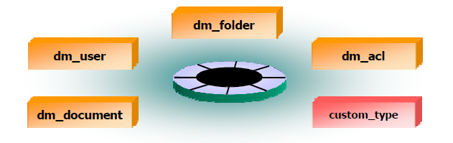
Documentum Object Type Names.
Documentum out of box Object Types are prefixed by dm_.
Custom Object types can have their own prefixes.
All Documentum objects can be referred to by an internal object type name or a label.
The internal object type name is the name of the type as it is represented in the database

Slide 33

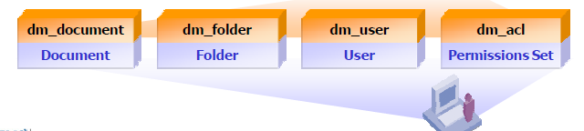
Documentum Object Type Names.
The internal object type name is used in DQL queries.
The internal object type name used by programs and applications.
The label is used for display purposes in client user interface.

Slide 34
Documentum Object Type Names.
Conventionally, internal names of predefined (defined by Documentum for Content Server or other client products) types start with dm, as described here:
dm_: (general) represents commonly used object types such as dm_document, which is generally used for storing documents.
dmr_: (read only) represents read-only object types such as dmr_content, which stores information about a content file.
dmi_: (internal) represents internal object types such as dmi_workitem, which stores information about a task.
dmc_: (client) represents object types supporting Documentum client applications. For example, dmc_calendar objects are used by Collaboration Services for holding calendar events.

Slide 35
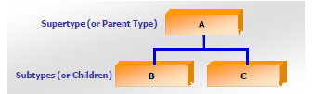
Object Type Hierarchy
Types are organized into a hierarchy
- Subtypes inherit all of the properties of the supertype.
-Subtypes usually have additional properties.
-Types B and C inherit all of type A's properties.
- In addition, B and C each have their own unique properties.
A type with no supertype is called a null type.

Slide 36
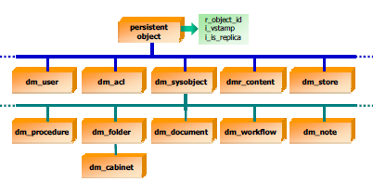
Documentum Object Types
This is a portion of the Documentum type hierarchy which are widely used.

Slide 37
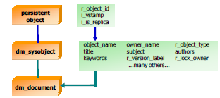
Inheritance
A subtype inherits all properties of its supertype
- In this example:
- dm_document is a subtype of dm_sysobject
- dm_sysobject is a subtype of persistent object
- dm_document inherits all of the properties of dm_sysobject
and persistent object

Slide 38
Documentum Object Types
The most commonly used predefined object type for storing documents in the repository is dm_document.
We have already seen how folders are used to organize documents. Folders are stored as objects of type dm_folder.
A cabinet is a special kind of folder that does not have a parent folder and is stored as an object of type dm_cabinet.
Users are represented as objects of type dm_user and a group of users is represented as an object of dm_group.
Workflows use a process definition object of type dm_process, while the definition of a lifecycle is stored in an object of type dm_policy.
There are 100+ object types which comes as a part of Documentum and more can be created as custom types.

Slide 39
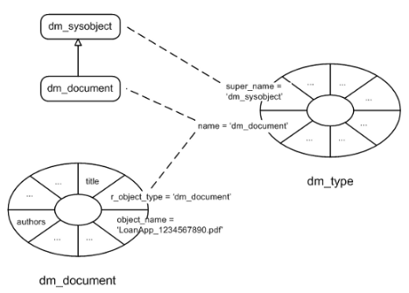
Documentum Object Types
Just like everything else in the repository, a type is also represented as an object, which holds structural information about the type.
This object is of type dm_type and stores information such as the name of the type, name of its supertype, and details about the attributes in the type.
The following figure shows an object of type dm_document and an object of type dm_type representing dm_document.
It also indicates how the type hierarchy information is stored in the object of type dm_type.

Slide 40
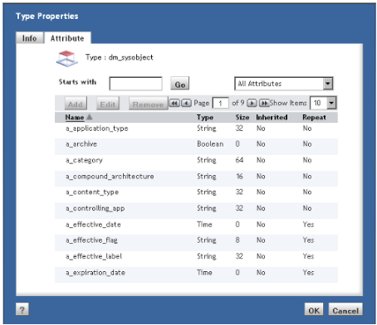
View Documentum Types and Properties.
The types present in the repository can be viewed using Documentum Administrator (DA).
The following screenshot shows some properties for the type dm_sysobject.
This screen provides controls to scroll through the properties when there are a large number of properties present.
The Info tab provides information about the type other than the properties.

Slide 41
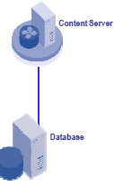
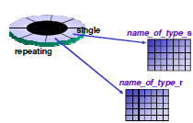
Type Storage
Content Server stores properties of each object type in up to two tables:
- name_of_type_s table stores an object’s single-valued properties
- name_of_type_r table stores an object’s repeating-valued properties

Slide 42
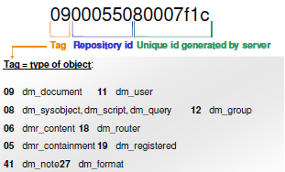
The r_object_id Property
The Content Server assigns a unique object ID to every object in the repository
- It Cannot be modified
Describes the object type and the repository in which it resides

Slide 43
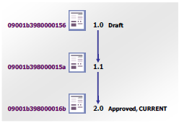
Versions and Object IDs
Each version of a document/object is a unique object in the repository
- Has a unique object ID even though it is logically a single document/object.

Slide 44
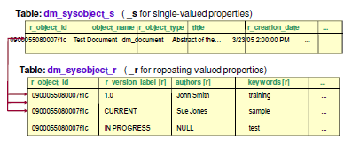

Type Storage Example: dm_document

Slide 45
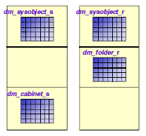
Points to note
When issuing a query against an object type, all single and repeating-valued attributes for that type are returned.
The type's tables are joined with the tables of its supertypes.
A request for information about a dm_cabinet object
returns property values from all the relevant tables
in the type hierarchy.
The dm_folder type contains no single-valued
attributes of its own.
The dm_cabinet type contains no repeating valued
attributes of its own.

Slide 46
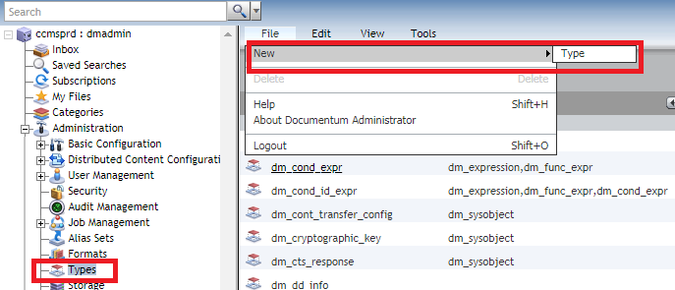
Documentum Object Type Creation.
Object Types can be created using Documentum Administrator (DA) or DQL or Composer.
Object Type Creation in DA :
Log into DA.
Navigate to ‘Types’ in the browser tree on the left.
In the ‘Types’, create a new type using the ‘File’ menu.

Slide 47
Documentum Object Type Creation.
Object Type Creation using DQL:
CREATE TYPE "mycustomtype" (firstname string(64),
country string(64) ,
age int,
height double,
phone string(10) REPEATING)
WITH SUPERTYPE "dm_document" PUBLISH;
Above script creates an object type mucustomtype with supertype as dm_document.
Object Type Modification using DQL:
- ALTER TYPE "mycustomtype"Add lastname string (64), height double, weight double PUBLISH
- Above script is to Modify a Simple Object Type (Adding new Attributes)

Slide 48
Modify Existing Attribute
Modify an existing attribute of a type :
- ALTER TYPE mycustomtype MODIFY firstname string (121)
- Above script Alters/Modifies an object type mycustomtype and attribute ‘firstname’ size is increased to 121 bytes.
Deleting an Attribute :
- ALTER TYPE mycustomtype drop weight
- Above script Alters/Modifies an object type mycustomtype and attribute ‘weight’ is deleted.

Slide 49
Object Type Deletion.
Dropping/Deleting an Object type using DQL :
- DROP Type ‘mycustomtype’
Note : There can be inconsistencies with the data attached if you drop a type. Make sure you delete all the objects attached to the type you are deleting first and proceed with the type deletion. Below is the Query to delete all objects at a time.
Delete All Objects of an Object type
- DELETE mycustomtype (all) objects
To Find all attributes of an Object Type :
- DESCRIBE mycustomtype

Slide 50
Summary
An object type is a pre-defined template of unique properties and methods .
The Documentum system contains over 100 object types.
Documentum out of box Object Types are prefixed by dm_.
A type with no supertype is called a null type.
Types are organized into a hierarchy. A subtype inherits all properties of its supertype.
Object Types can be created using Documentum Administrator (DA) or DQL or Composer.

Slide 51
Test Your Knowledge
A __________________ is a pre-defined template of unique properties and methods .
TRUE/FALSE Documentum out of box Object Types are prefixed by dm_.
3. Which of the following is not a component of an r_object_id value
A) Unique identifier
B) Content type identifier
C) Repository identifier
D) Object type identifier
4. True/False: No matter how many versions a document
has, all versions will have the same r_object_id value.
(Check Notes for Answers )
Notes:
Answers:
Object Type
True
B
C

Slide 52
Test Your Knowledge
5. The dm_folder type contains no single-valued attributes of its own. TRUE/FALSE.
6. A _______ is a single instance of a pre-defined type.
Notes:
5. TRUE
6. Object

Slide 53
Try This :
Try below Hands on exercise in Documentum Administrator.
Try Creating new object type ‘Custom_Object_Type’
Modify the object Type.
Query and find the object type and properties.
ALL THE BEST.

